Slide 1
University of Basrah Al-zahra college of medicine
Ministry of higher Education and Scientific Research
Academic year 2021-2022
2nd year S-3
Cardiovascular Module
Session: Date: 24/11/2021
Lecture :drugs acting on cardiovascular system
Module staff:
Dr Firas Rashid (Module leader) Dr Amed Bader (module co-leader) Dr Jawad Ramadhan Dr Nawal Mustafa Dr Mohammed Adil Dr Nehaya Al-Aubody Dr Amer Qasim Dr Hadeel S. Al Ali Dr Asaad Hassan Dr Hussain Abdul Ameer
Dr. Ammar Salih

Slide 2
University of Basrah Al-zahra college of medicine
Ministry of higher Education and Scientific Research
Learning Outcomes
To know drugs that effect cardiovascular system
The mechanism of action of these drugs and how they effect the CVS
To point out to some cardiovascular disease and outline some of their treatment.

Slide 3
University of Basrah Al-zahra college of medicine
Ministry of higher Education and Scientific Research
what do we want to take care of ???
1- our patient with Hypertension:
Drugs that are broadly used in treatment are :
1-Angiotensin converting enzyme inhibitors
2- calcium channel blockers
3- diuretics
4- others

Slide 4
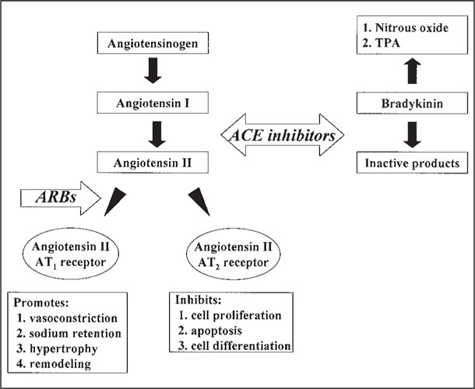
University of Basrah Al-zahra college of medicine
Ministry of higher Education and Scientific Research
1- Angiotension converting enzyme inhibitors and receptor blockers:

Slide 5
University of Basrah Al-zahra college of medicine
Ministry of higher Education and Scientific Research
Major systemic effects:
Vasoconstriction – binding to AT1 and AT2 (not well defined)
NaCl and H2O reabsorption – direct effect on renal tubule
Increased secretion of aldosterone
Na and H2O retention
Interstitial fibrosis via increased collagen deposition in the extracellular matrix of heart tissue

Slide 6
University of Basrah Al-zahra college of medicine
Ministry of higher Education and Scientific Research
Major result of inhibiting ACE :
less production of angiotensin II--- Reduced pre-load, afterload, sympathetic activity, cardiac remodeling , hyperkalemia,
Additional mechanisms
ACE is a kininase –inhibiting ACE---Bradykinin = vasodilation (and probably cough)
Reduced sympathetic activity unknown mechanism
Increased prostaglandin synthesis –vasodilation
Possible angioedema connection

Slide 7
University of Basrah Al-zahra college of medicine
Ministry of higher Education and Scientific Research
Blocks angiotensin II receptors:
Angiotensin II, kinins and prostaglandins not affected so….
No cough, very limited angioedema
Same clinical effects as ACE-I

Slide 8
University of Basrah Al-zahra college of medicine
Ministry of higher Education and Scientific Research
Examples of ACI ( Captopril, lisnopril , enalpril , Ramipril…)
ARBS ( candesartan , losartan , valsartan , telmisartan …)
What are the side effect of these drugs ???and what are the uses of ACEIs in clinical medicine

Slide 9
University of Basrah Al-zahra college of medicine
Ministry of higher Education and Scientific Research
2-calcium channel blockers:
Bind to L-type calcium channels on vascular smooth muscle, cardiac myocytes and cardiac nodal tissue (sinoatrial & atrioventricular nodes)
Vascular SM relaxation = vasodilation
Myocardial force generation = (-) inotropy
Heart rate = (-) chronotropy
Conduction velocity = (-) dromotropy
Useful in HTN Angina Arrhythmias

Slide 10
University of Basrah Al-zahra college of medicine
Ministry of higher Education and Scientific Research
Calcium channel blockers:
We have two classes of calcium channel blockers:
Dihydropyridines (-ipines) : (nifedipine, amlodipine, felodipine, isradipine,nicardipine, nimodipine)
High vascular selectivity (arterial)
Can lead to reflex tachycardia and
Negative intropy and may offset reduction in myocardial O2 demand.
Second generation (amlodipine, felodipine etc) have little or no (-) inotropic effects – can treat HTN in systolic heart failure (not first line choice).

Slide 11
University of Basrah Al-zahra college of medicine
Ministry of higher Education and Scientific Research
NON-DIHYDROPYRIDINES
Phenylalkylamine – Verapamil
Relatively selective for myocardium – ( -) effect on AV conduction and SA node --less vasodilation
Angina, coronary vasospasm, SVT
Benzothiazepine – Diltiazem
Both cardiac depressant - ( -) effect on AV conduction and SA node and vasodilator activity between verapamil and dihydropyridines

Slide 12
University of Basrah Al-zahra college of medicine
Ministry of higher Education and Scientific Research
What are the common side effect of Calcium channel blockers ??

Slide 13
University of Basrah Al-zahra college of medicine
Ministry of higher Education and Scientific Research
3-DIURETICS
PCT – Carbonic Anhydrase Inhibitors = weak diuretic predominant effect on NaHCO3
Loop Of Henle – loop diuretics (Furosemide, torsemide ,
Bumetanide)
thiazide diuretic ( Distal Convoluted tubule): (hydrochlorothiazide, Chlorthalidone …)
Potassium sparing diuretics: (spironolactone) ( prevent cardiac remodelling)

Slide 14
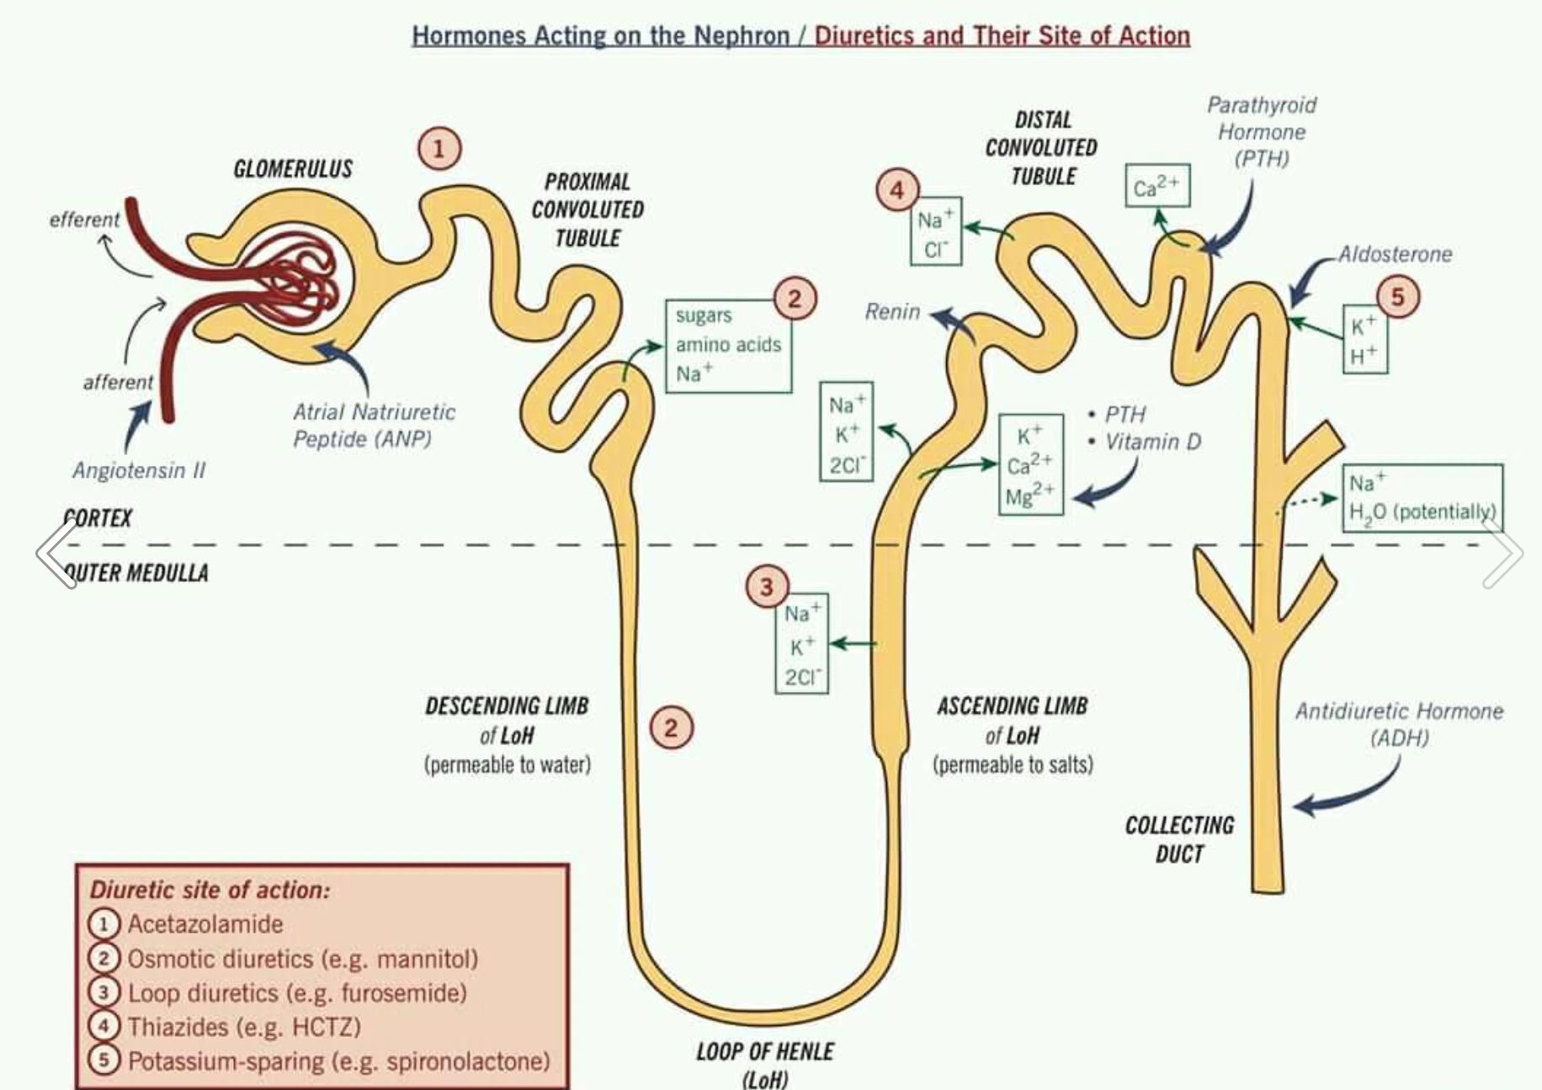
University of Basrah Al-zahra college of medicine
Ministry of higher Education and Scientific Research

Slide 15
University of Basrah Al-zahra college of medicine
Ministry of higher Education and Scientific Research
What are the main uses of diuretics in cardiovascular disease??

Slide 16
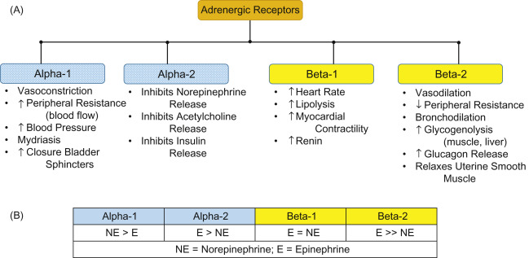
University of Basrah Al-zahra college of medicine
Ministry of higher Education and Scientific Research
Adrenergic drugs :

Slide 17
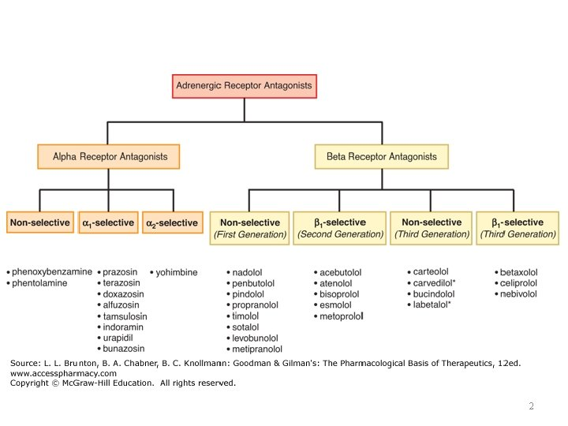
University of Basrah Al-zahra college of medicine
Ministry of higher Education and Scientific Research

Slide 18
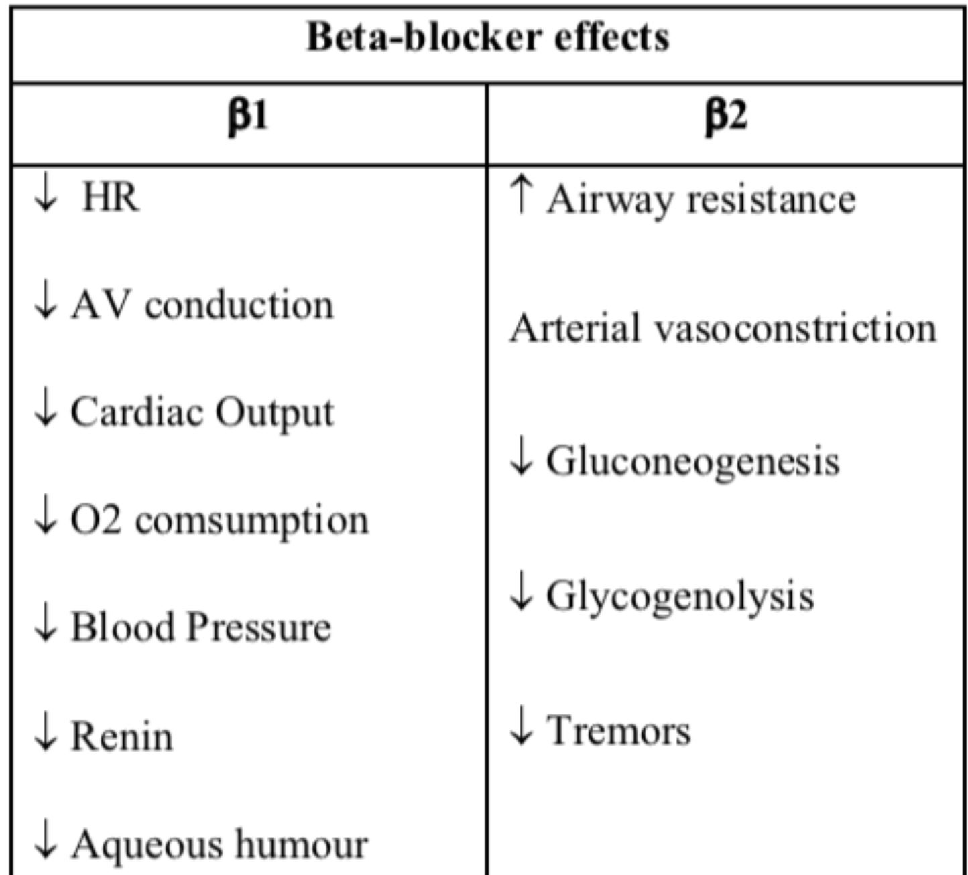
University of Basrah Al-zahra college of medicine
Ministry of higher Education and Scientific Research

Slide 19
University of Basrah Al-zahra college of medicine
Ministry of higher Education and Scientific Research
Side effect and contra indication of Beta blockers??
What are the uses of beta blockers in clinical medicine ??

Slide 20
University of Basrah Al-zahra college of medicine
Ministry of higher Education and Scientific Research
What about patient with arrhythmia ???
What’s arrhythmia ? Types??

Slide 21
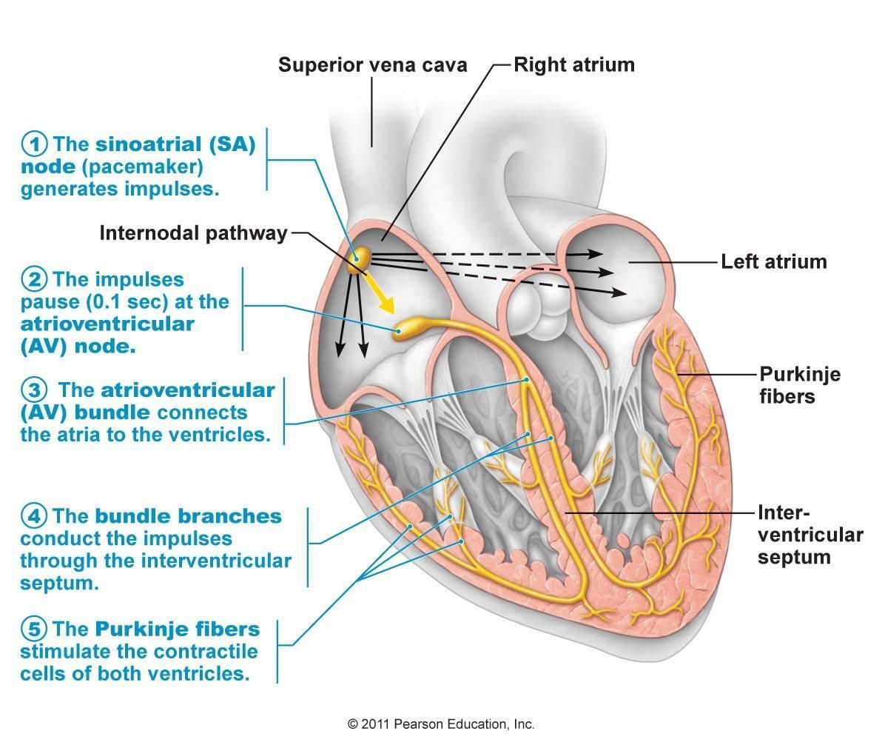
University of Basrah Al-zahra college of medicine
Ministry of higher Education and Scientific Research

Slide 22
University of Basrah Al-zahra college of medicine
Ministry of higher Education and Scientific Research

Slide 23
University of Basrah Al-zahra college of medicine
Ministry of higher Education and Scientific Research
DIGOXIN
ORAL INOTROPE
Inhibition of Na+/K+-ATPase ion transport system
accumulation of intracellular Ca++ which binds to troponin-C -- increased contractility (inotropy)
Increases vagal activity to the heart
reduced sinoatrial firing rate = (-)chronotropy and reduces conduction velocity of impulses through the AV node = (-) dromotropy.
May decrease sympathetic tone by: increase in CO, normalization of pathologic baroreflex response.
Used in the treatment of atrial fibrillation in case of heart failure.
Caution due to narrow therapeutic index.
( what’s digoxin toxicity and numerate factor that effect digoxin level)

Slide 24
University of Basrah Al-zahra college of medicine
Ministry of higher Education and Scientific Research
What about patients with ischaemic heart disease ??? Peripepheral vascular disease ??
The main drugs that we use are:
Antiplatelet
Anti coagulant
statin
Calcium channel blockers
Beta blockers
ACEIs

Slide 25
University of Basrah Al-zahra college of medicine
Ministry of higher Education and Scientific Research
Antiplatelets and anti coagulant:
GOALS: prevention or treatment of clots (DVT/PE/CVA)
Activated platelets secrete:
Thromboxane A2, adenosine diphosphate (ADP), serotonin, prostaglandins, and more
Activated platelets bind to fibrinogen via glycoprotein (GP) IIb/IIIa receptor
Aspirin
Irreversibly acetylates and inactivates Cyclo-oxygenase (COX) for the life of the platelet
COX mediates the biosynthesis of prostaglandin, thromboxanes (TxA2)
ASA eventually will lead to decrease platelet aggregation
Adenosine diphosphate Purigenic 2Y12 Receptor Inhibitors (ADP P2Y12)
Clopidigrel –Plavix® -irreversible binding.
Ticagrelor - Brilinta® - reversible inhibition.
Prasugrel - Effient® - irreversible binding.

Slide 26
University of Basrah Al-zahra college of medicine
Ministry of higher Education and Scientific Research
ANTICOAGULATION
Inhibit thrombin generation
Vitamin K antagonists : Warfarin Blocks Vit K synthesis of clotting factors II, VII, IX, X and proteins C & S (anticoagulants)
Direct thrombin inhibitors: (NOAC –noval oral anticoagulant-
Rivaroxiban, apixiban, dabigatran)
How we can make use of anti coagulant to treat cardiovascular diseases?? And what form of anticoagulant available??

Slide 27
University of Basrah Al-zahra college of medicine
Ministry of higher Education and Scientific Research
VASODILATORS Nitrodilators
We have two types of nitrodilator:
Those that release Nitric Oxide spontaneously –sodium nitroprusside which is often used in hypertensive emergencies
Those that form NO via enzymatic process – organic nitrates -nitroglycerin, isosorbide mono & dinitrate which decrease ventricular preload, relation phase and enhance blood flow to the myocardium mainly used in ischaemic heart disease
NO via decreasing intracellular calcium concentrations and activating K+ channels causes smooth muscle relaxation

Slide 28
University of Basrah Al-zahra college of medicine
Ministry of higher Education and Scientific Research
Thank you

Slide 29
University of Basrah Al-zahra college of medicine
Ministry of higher Education and Scientific Research
Refrences :
Davidson v 23 text book of internal medicine
Mediscape.

